Slide 1
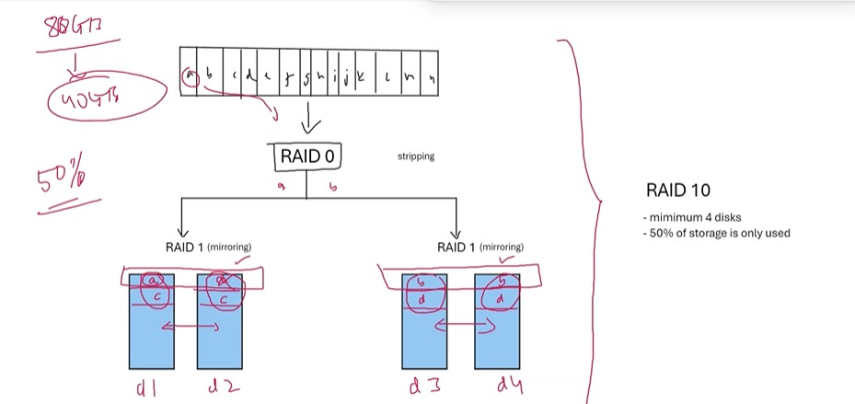
Azure we have redud-
LRS-CHEAPONE,LOCALLY REDUDAN,
ZRS-ZONE REDUDAN STORAGE.COATLY THAN LRS BUT CHEAPER THAN GRS
,GRS-geo redudant storage.the expensive one
storagE service:-
Storagr topology:-
-it is the arrangement or the config of storage devices within a network.
-DAS,NAS,SAN
-RAID 0 (Stripping) -RAID 1 (Mirroring) -RAID 2 -RAID 3 -RAID 4 - RAID 5 (striping with part -RAID 6 (Double parity) -RAID 10 (Mirroring + Stripping
RAID-Redundant aray of independence inexpdisk
-its a low-cost solution of storing the data.

Slide 2
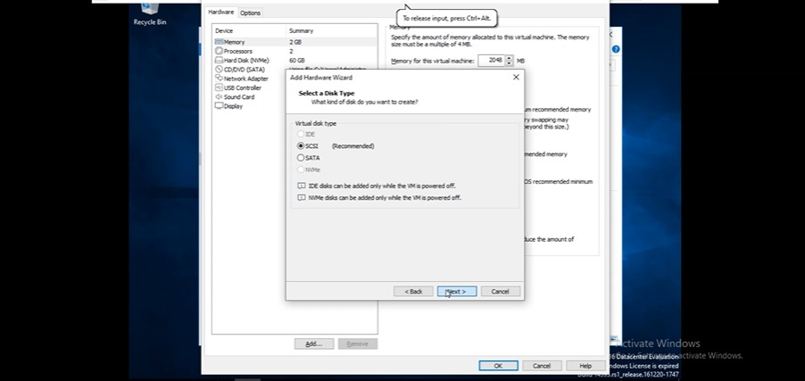
Open gui machine and add 2 disk of 5 gb

Slide 3
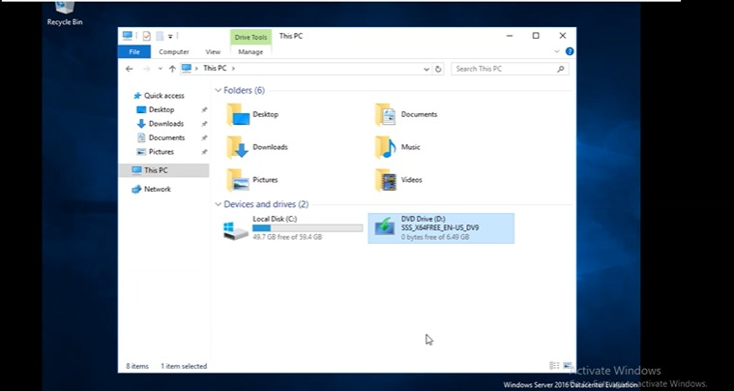

Slide 4
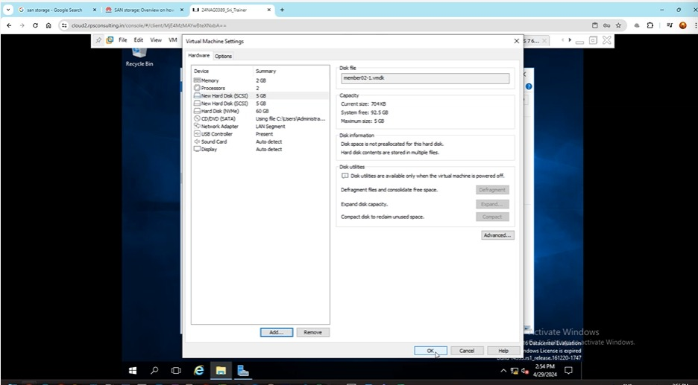
Adding 2disk and check it on disk management wheter it done or not

Slide 5
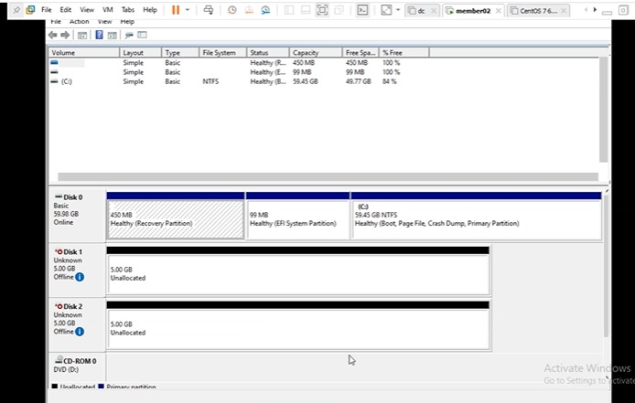

Slide 6
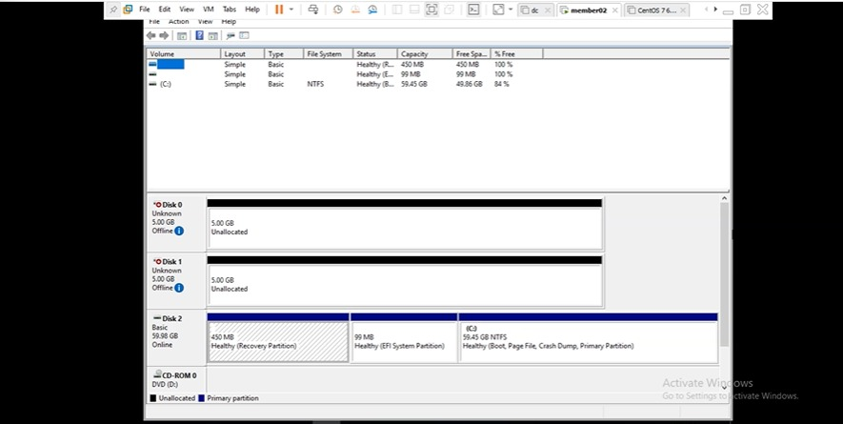

Slide 7
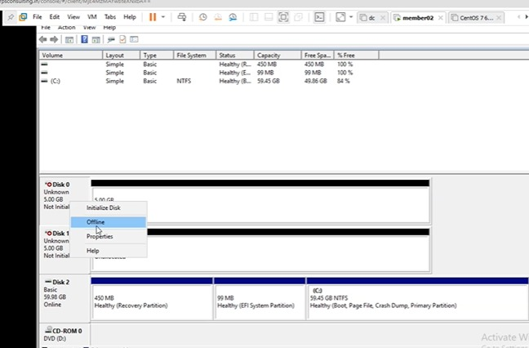
Right clk and online it.

Slide 8
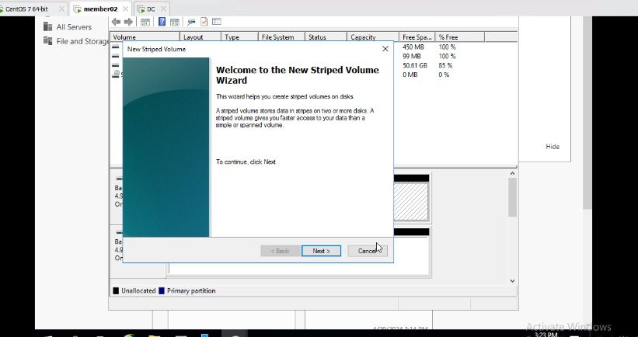
Right click and enter new stripped volume

Slide 9
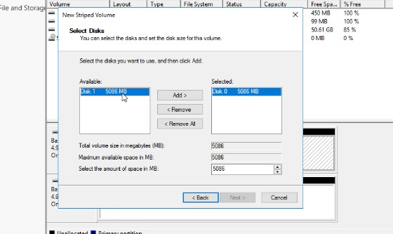
Add disk

Slide 10
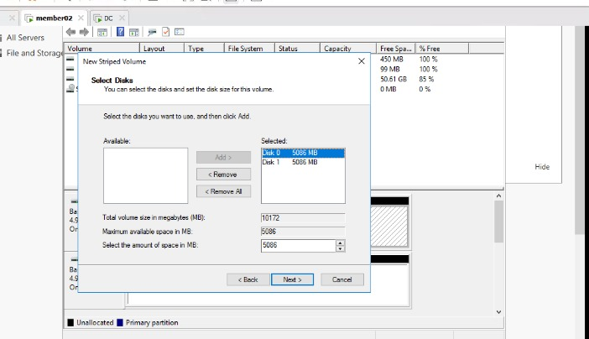
Next

Slide 11
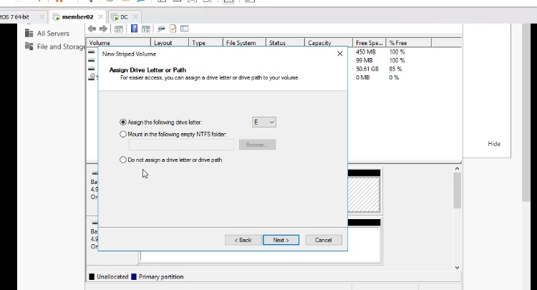
Next

Slide 12
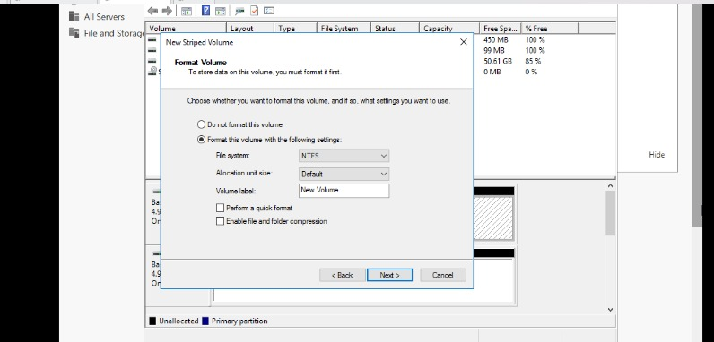
Change the volume name and next

Slide 13
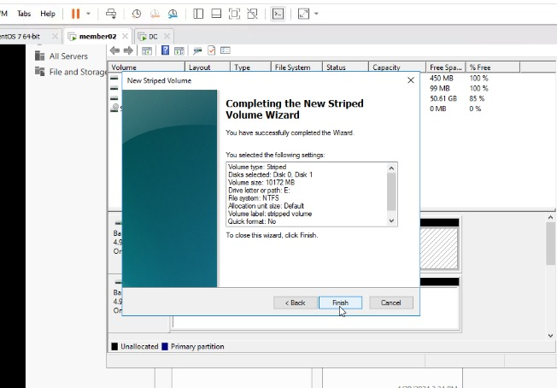
Finished it

Slide 14
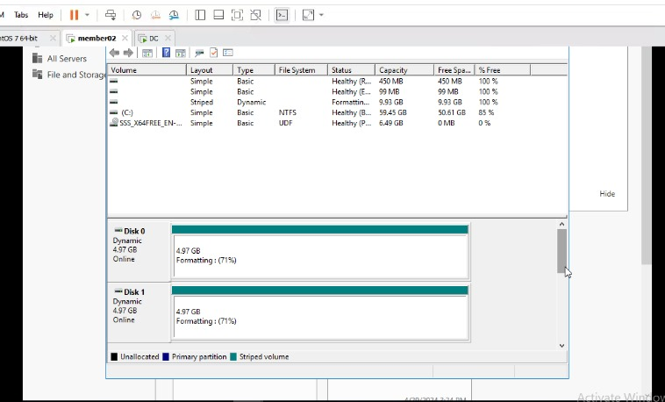
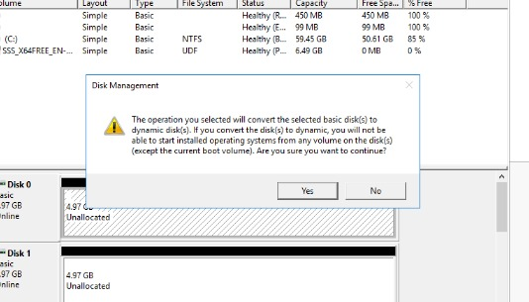
Click on yes and now disk become unallocated to healthy

Slide 15
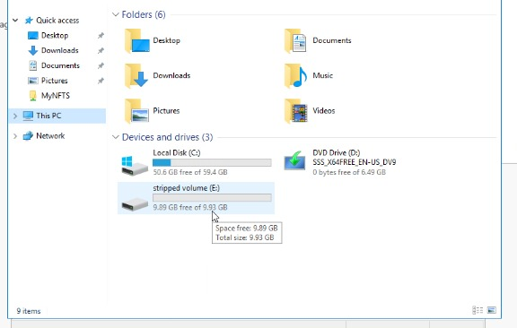
Now this task is done

Slide 16
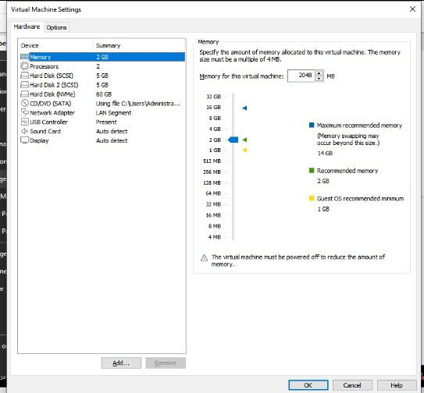
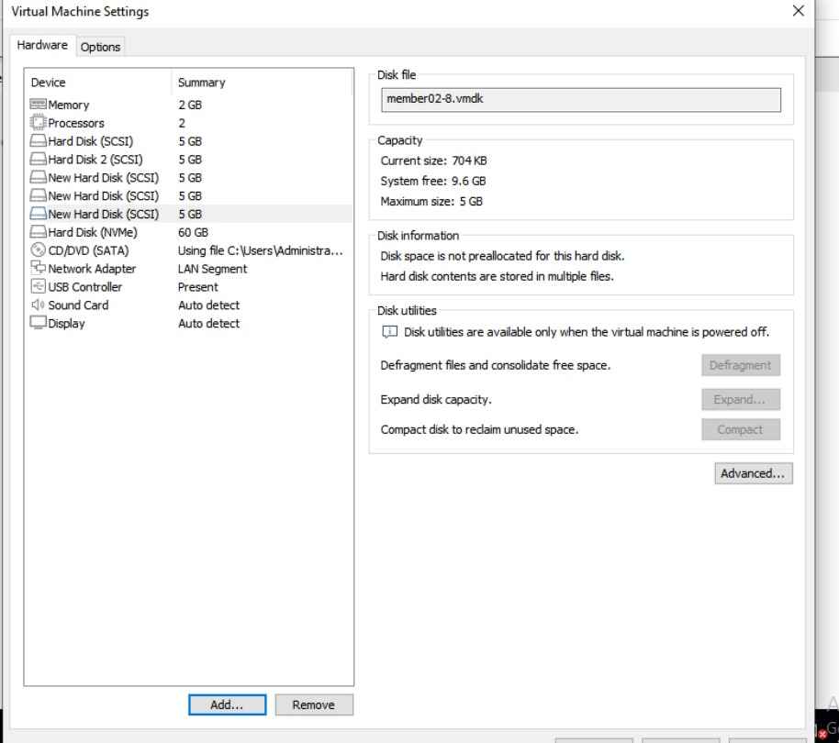
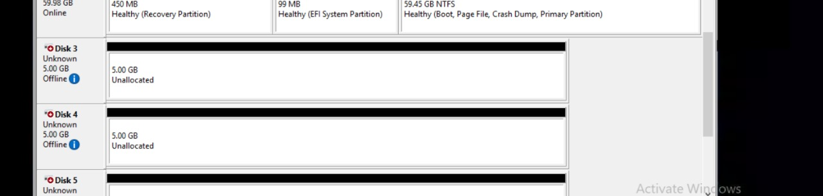
Task 2Add 3disk

Slide 17
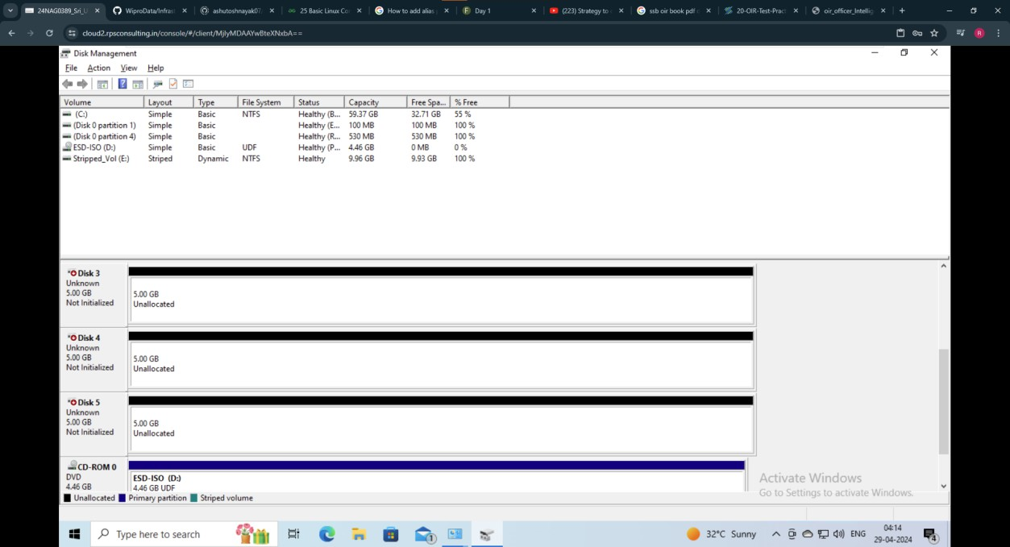
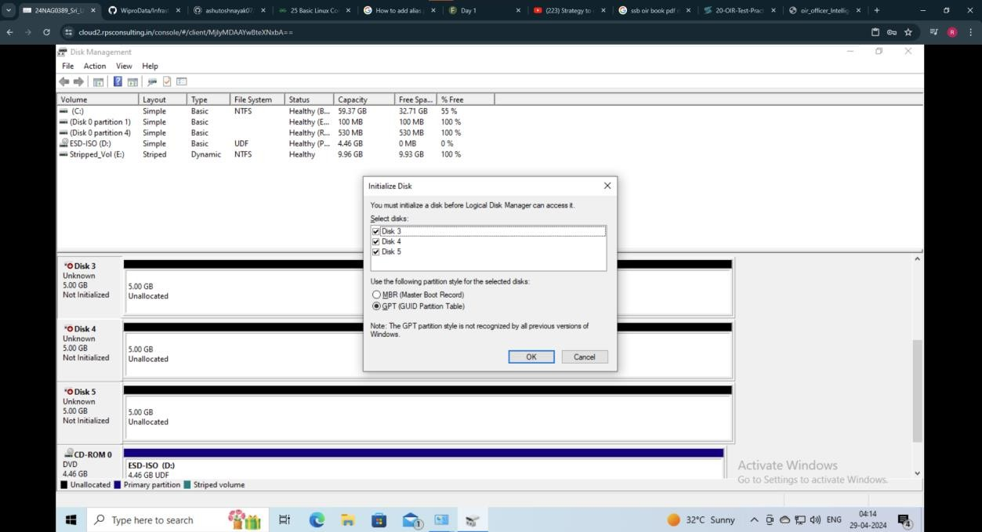

Slide 18
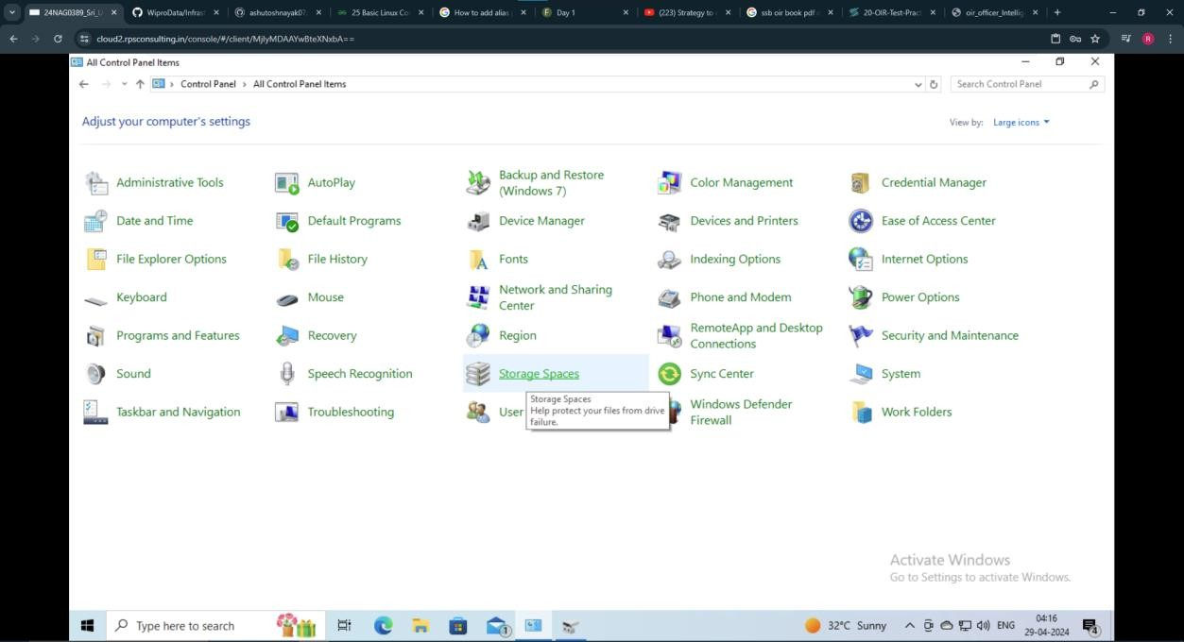
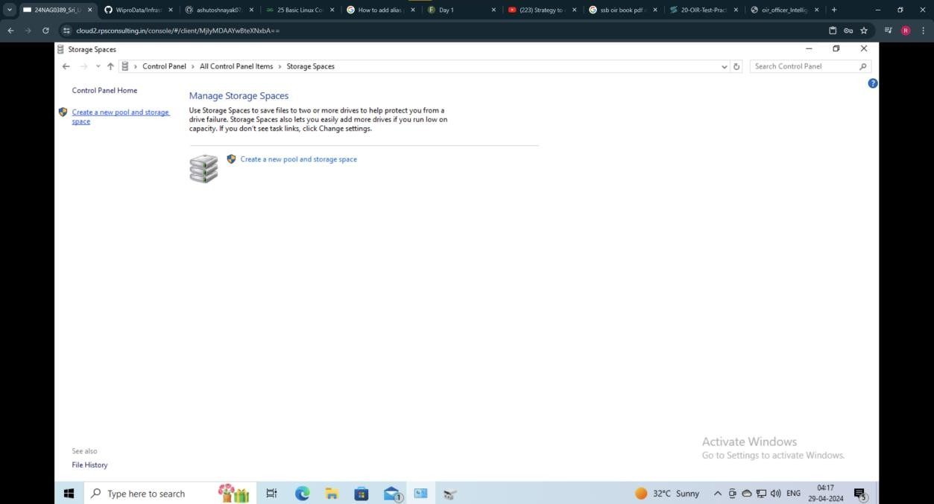

Slide 19
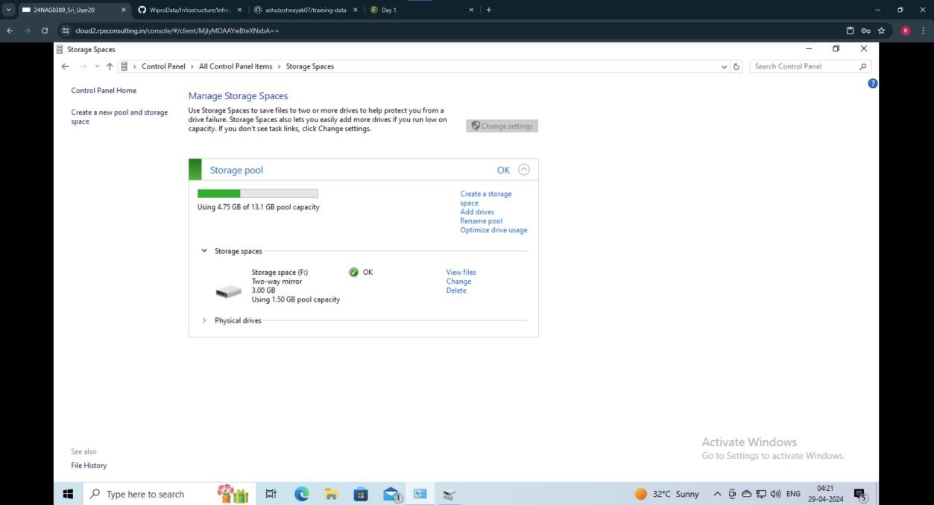

Slide 20
Backups:------------ is the process of creating a copy of data for availability & easy to recover.- it is useful in case of: - data loss - corruption - accidental deletion - data protection - disaster recovery - business continuity- methods: 1. Manual backups 2. automated backupsEnterprise-level backups ex: - Commvault - Vertias Backup - Veeam backupSmall-Mid level: - Acronis backup - carbonite
Small-Mid level: - Acronis backup - carbonite Cloud backup: - AWS S3 - Azure backup - Google CLoud Backup Open source: - Bacula - Amanda - Duplicati Backup architecture components:-------------------------------- source system- backup client- backup server- storage devices- backup media- backup policies- backup methods - full backup - incremental backup - differential backup- monitoring tools

